Slide 1
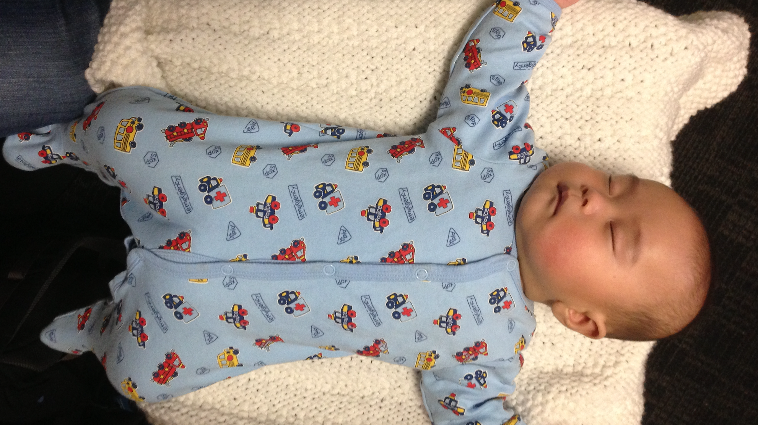
Burn, Baby, Burn: Pediatric Fever
Dina Wallin, MD
February 18, 2024
Notes:
This is one of my favorite topics, and this is because it used to be one of my least favorite topics– I’d feel a sense of dread every time a febrile kid would come through the door, because I was scared of missing something serious, but also didn’t want to inflict torture upon a kid who already felt terrible, by obtaining unnecessary testing. My hope is, by the end of this brief didactic and our time together in the small groups, you will feel much more comfortable and this will become one of your favorite topics too. Before we begin--

Slide 2
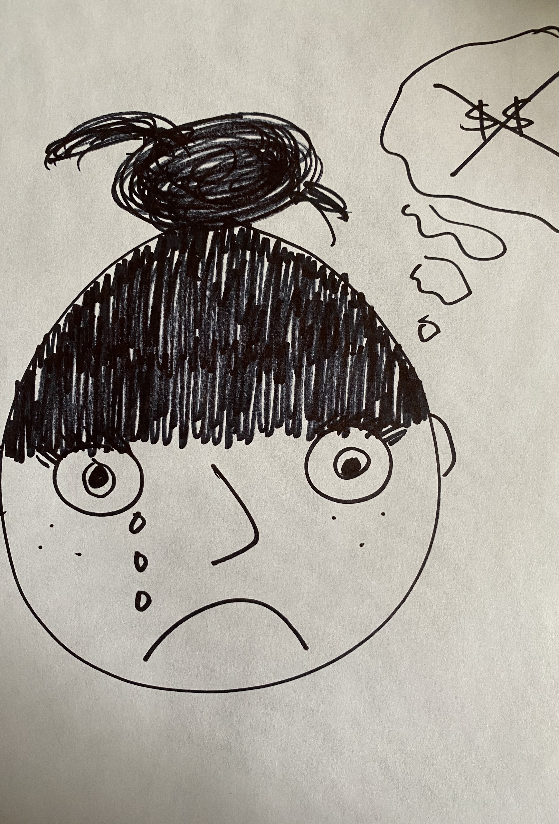
No disclosures

Slide 3
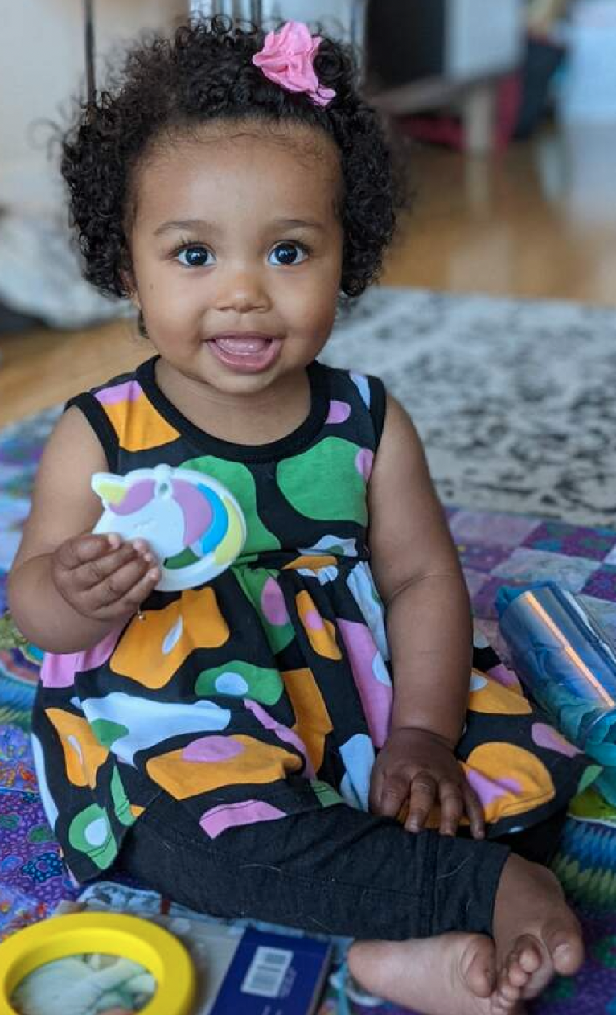
Goal
To streamline evaluation and management of pediatric fever, with a focus on the most common and most serious diagnoses
Notes:
Goal for this brief didactic and the cases to follow is

Slide 4
Objectives
After attending this workshop, learners will be able to:
Apply age-based evaluation algorithms for pediatric fever
Describe common causes of fever in children
Explain critical aspects of management of the febrile pediatric patient
Notes:
And just to start, a basic

Slide 5
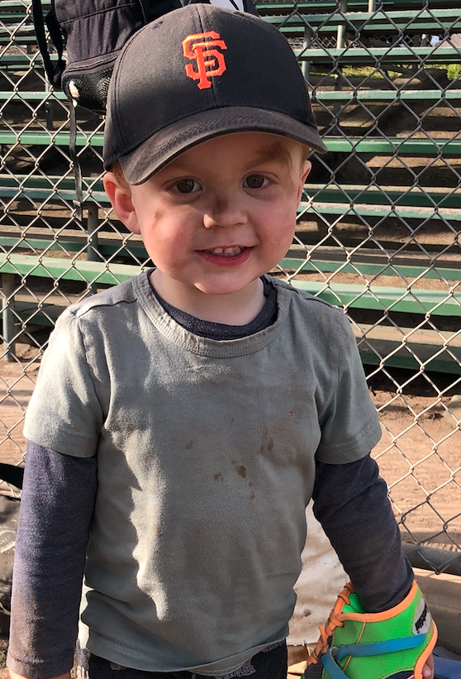
Introduction

Slide 6
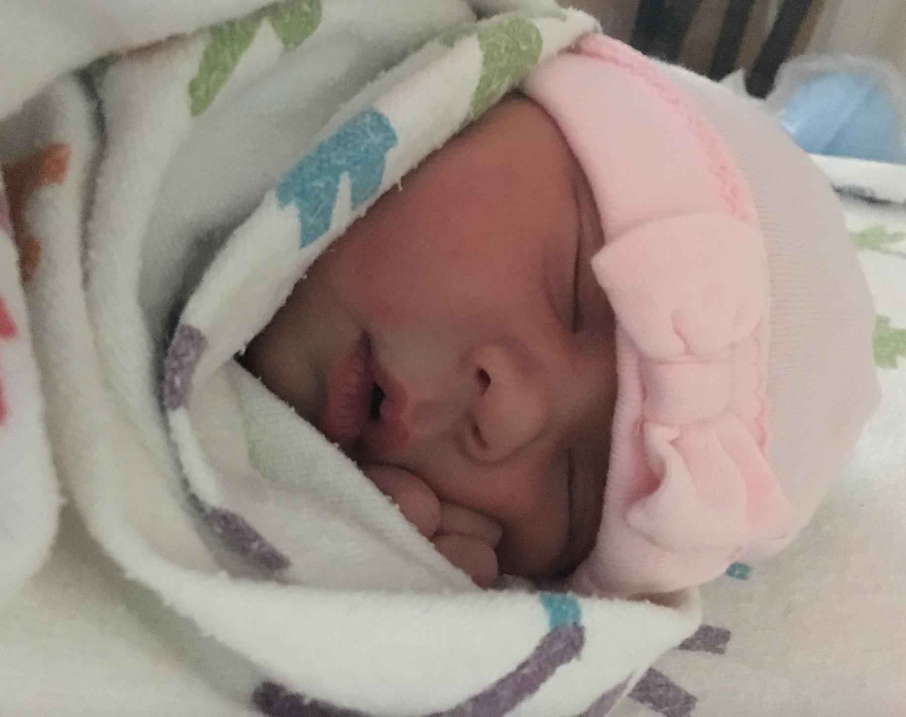
Background
Fever is super common!
High morbidity
Highest risk:
Very young infants (< 60 days)
Immunocompromised children
Children with chronic medical conditions
Un(der)vaccinated
Notes:
Now, while many of you likely experienced a pause in pediatric volumes early in the pandemic, I bet winter wasn’t light, was it? Fever accounts to 10-30% of pediatric ED visits and, because it’s so common. There is high morbitdity– days off of work or school, weight loss/developmental setbacks, and, worse, damage to structures (scarring of kidneys or Tms). Mortality, thanks to vaccines, is no longer very high, but because of the sheer prevalence of pediatric fever, a not insignificant number of children will die from febrile illnesses every year. Especially those under 28 days. Neutropenia, immunodeficiency, etc. Including sequelae of prematurity. I put this in italics because we have such phenomenal herd immunity as a result of vaccines that, in the otherwise healthy older child, vaccine status matters a bit less.

Slide 7
Common infections
Viral infections!
Upper respiratory infection (URI)
Acute gastroenteritis
Exanthems, including gingivostomatitis
Croup
Bronchiolitis
Covid
Urinary tract infection (UTI)
Acute otitis media
Pneumonia
Invasive bacterial illnesses (IBIs)
Notes:
By far and away, we are most often dealing with viral infections. The great news about this is, viral symptoms can assist us with our diagnosis, most viral infections are benign and self-resolving (or have easy treatment), and most don’t need to be tested for. Covid can cause all of these syndromes in kids, and I’m not going to talk Covid today– y’all have had enough! All I will say is that although all we’ve been thinking about for the past 2+ years is Covid, other, more serious infections haven’t gone away. And what are the other infections we think of? most commonly with E. coli– bacteremia, meningitis. OK, so, we know that we see lots of febrile kids, and we know what infections we may encounter– let’s get into age-specific stuff.

Slide 8
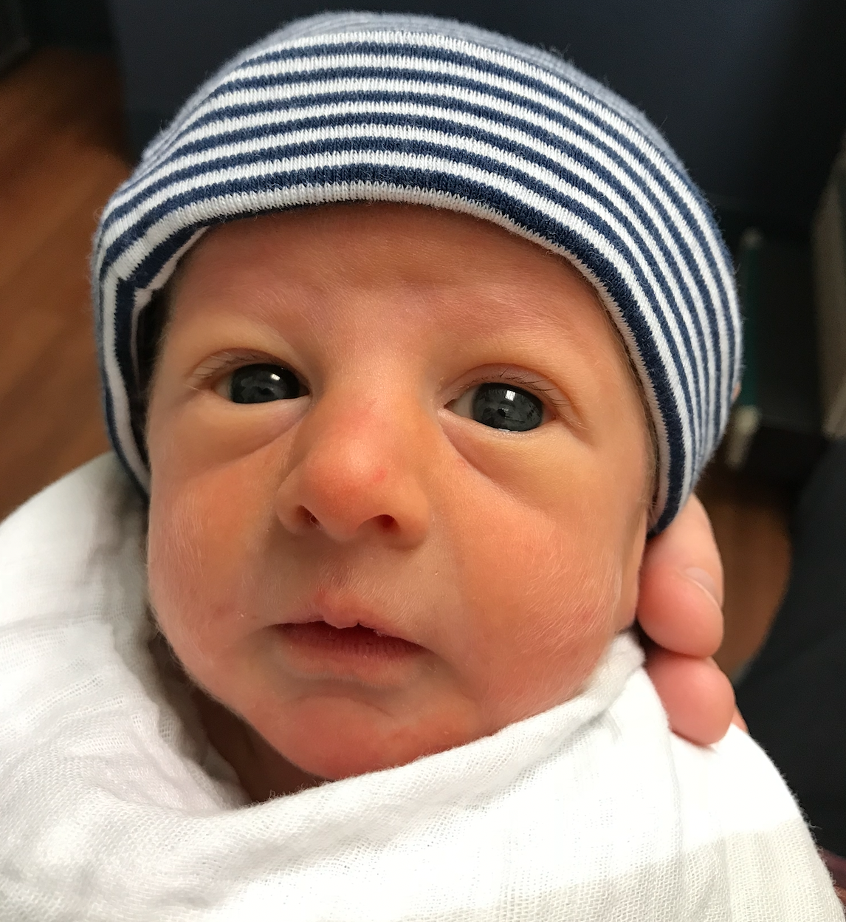
(Very) Young Infants
Notes:
I want to make it clear that all of the children I’m going to discuss today are WELL-APPEARING children. For sick-appearing children, focus on ABCs and resuscitation via PALS guidelines. This is for the much more common patient, the happy, or even a bit crabby, febrile child without evidence of shock.

Slide 9
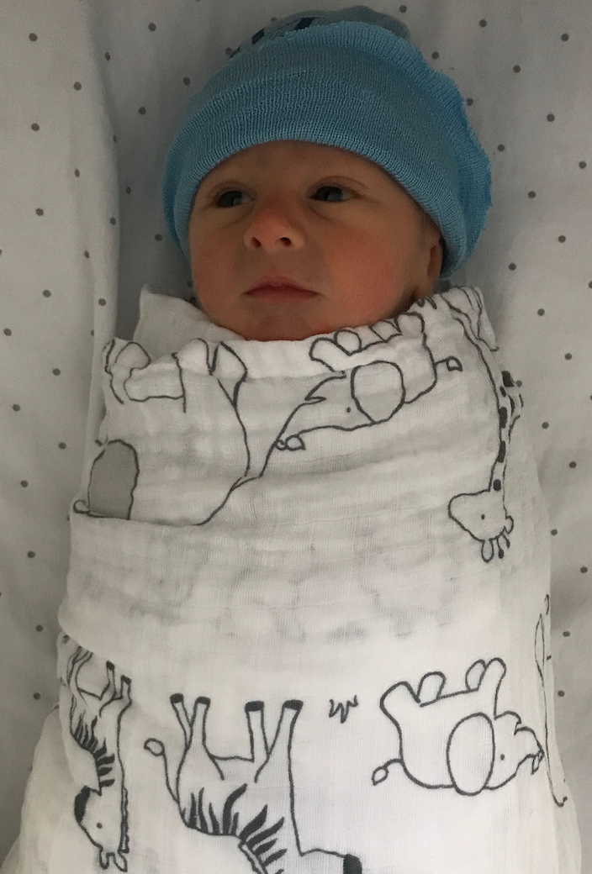
Neonate: 0-28 days
Very high risk!
Septic workup:
Blood culture, cath urinalysis and urine culture
Lumbar puncture with CSF culture, gram stain, cell count with diff, glucose, protein, viral PCR studies
Consider inflammatory markers: procalcitonin, CRP, CBC with differential
Consider respiratory virus PCR*
Parenteral antimicrobials
Hospital admission
Notes:
Neonatal immunodeficiency: immaturity of T cell function. Don’t do much– hard to evaluate. The good news is, these kids don’t require much thought from us– they require a full sepsis workup, IV antimicrobials, and admission. We’re going to discuss this in much more detail during our small group, BUT– what is a “septic workup?” positive respiratory virus PCR does not preclude full workup

Slide 10
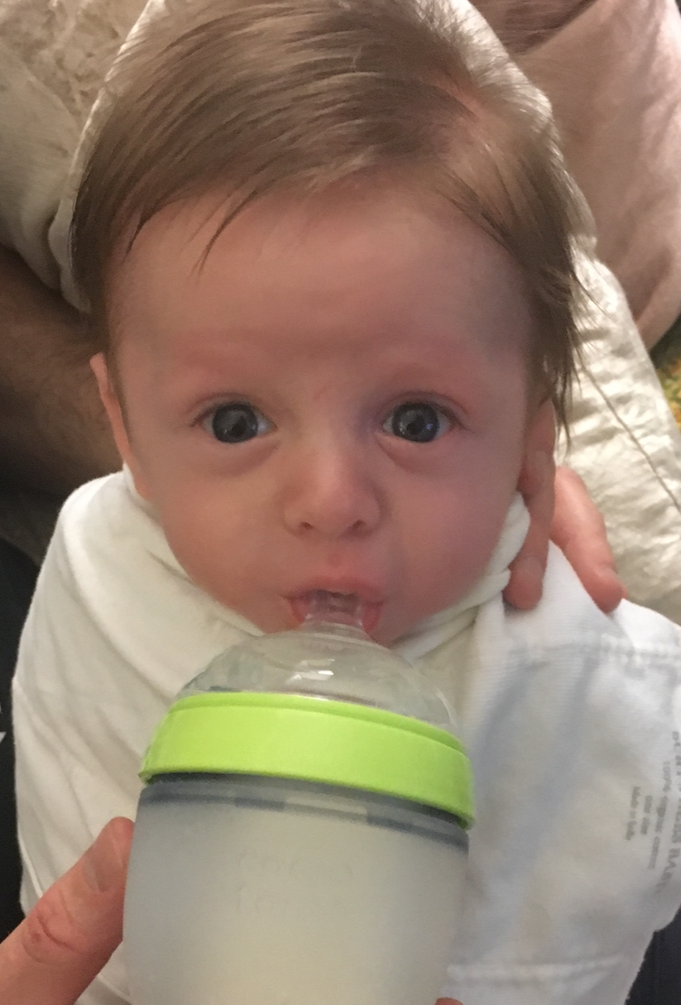
Young infant: 29-60 days
Intermediate risk
Minimum workup:
Blood culture, cath urinalysis and urine culture
Inflammatory markers
Consider LP if inflammatory markers abnormal
Consider respiratory virus PCR
Notes:
They’re doing more, so caregivers have a better idea of baseline; they’re bigger and stronger; many structural anomalies will have fully declared themselves; a full month of breastmilk; but on other hand, still very small, no vaccines yet. However, here is where herd immunity changed EVERYTHING over the past 10-20 years. Whereas all of these infants would have needed a full septic workup and admission a mere 10 years ago, now we might even send these kids HOME! Again, we’ll apply all of this in the small groups, but what is a recommended workup for the febrile infant 29-90 days?

Slide 11
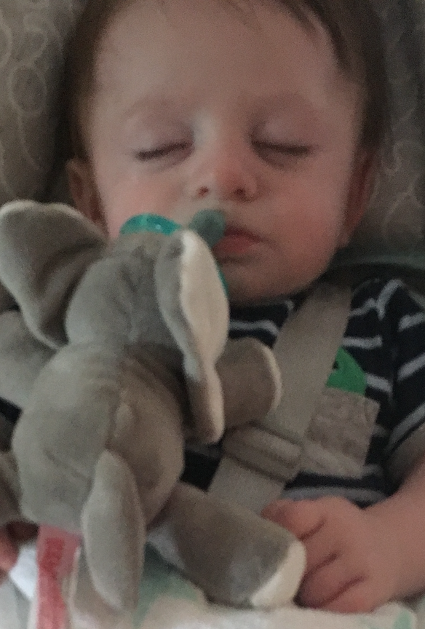
Young infant: 29-60 days
Disposition pending:
CSF results, if obtained
Reliable caregiver phone number and transportation
Caregiver willingness to closely observe patient and communicate changes
Access to 12-24 hour follow-up
Oral challenge

Slide 12
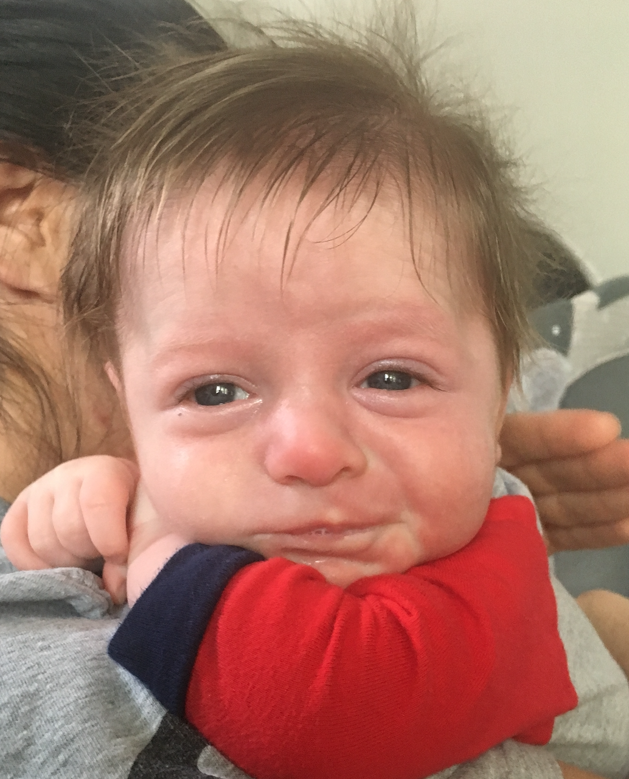
Whew!
Notes:
OK, that was a LOT of information and, again, don’t worry if you didn’t write all of it down. We’re going to practice this together very soon. Now, moving on to our slightly older infants, those 61 days-6 months old.

Slide 13
Infants 61 days-6 months
Lower risk!
H&P more reliable
History
Hydration
Energy
Associated symptoms
Sick contacts
Prior infections
Physical
Ears
Mouth
Lungs
Skin
Notes:
PO intake and UOP; fussiness, somnolence, playing? Resp distress, V/D, rash, etc. Including the palms of the hands and soles of the feet!

Slide 14
Infants 61 days-6 months
Consider cath urinalysis:
Fever ≥ 39
No suspected alternative source
Fever + emesis alone
Symptomatic
Fever for ≥ 3 days
Consider respiratory virus PCR
Clear expected course and return precautions
Notes:
Being under 6 months carries increased risk of UTI no matter who you are. We’ll discuss more in cases, but here are some risk factors I think about: the only ones which would actually make a difference are Covid and influenza. OK, so those are our older infants. Now, moving on to everyone else:

Slide 15
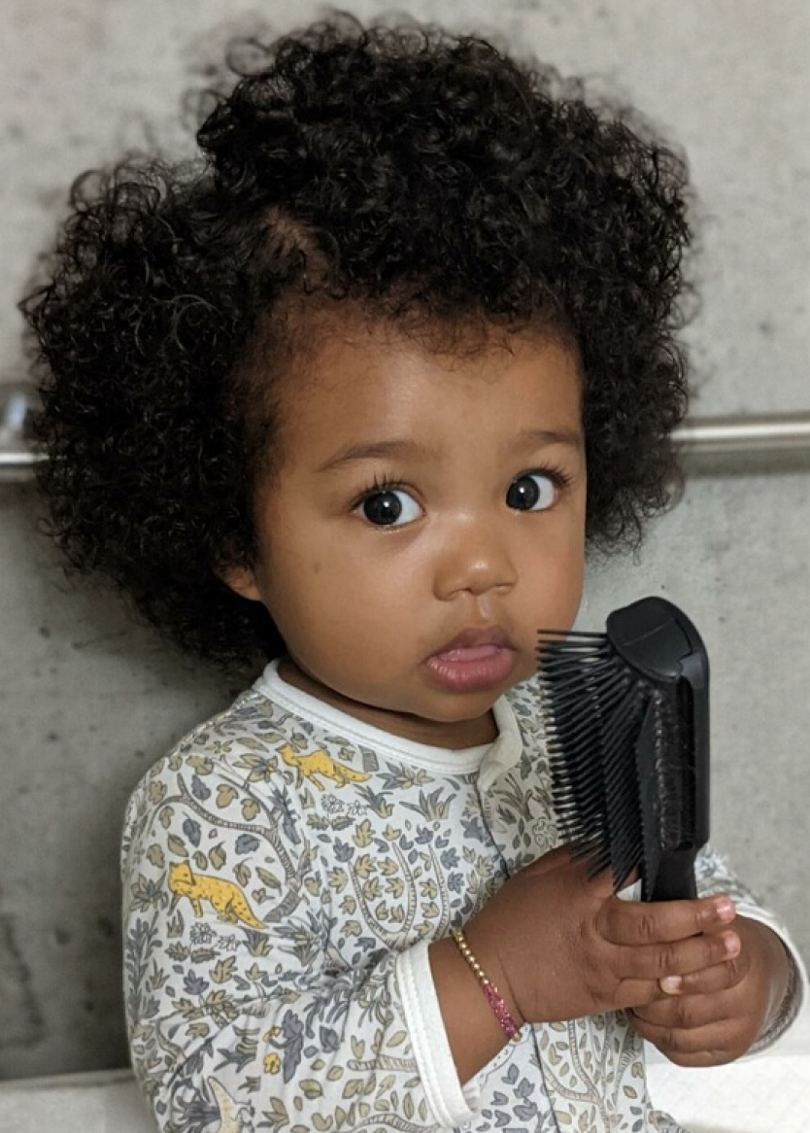
Older infants and children
Notes:
I know in your head lumping together a 6 month old with a 9 year old seems weird, but really, this is how pediatric emergency physicians think!

Slide 16
Older infants and children
Symptom-based evaluation
Urinalysis in appropriate kids:
Uncircumcised males under 1 year
Females under 2 years
Symptomatic
Prior UTI and no clear source
Consider respiratory virus PCR
No routine lab testing or imaging
Notes:
It’s a bit more nuanced than this, and we’ll discuss in our small groups, but this is a solid rough framework. Again, only Covid or influenza (in under 5, especially under 2; and those c chronic conditions), other than a Covid

Slide 17
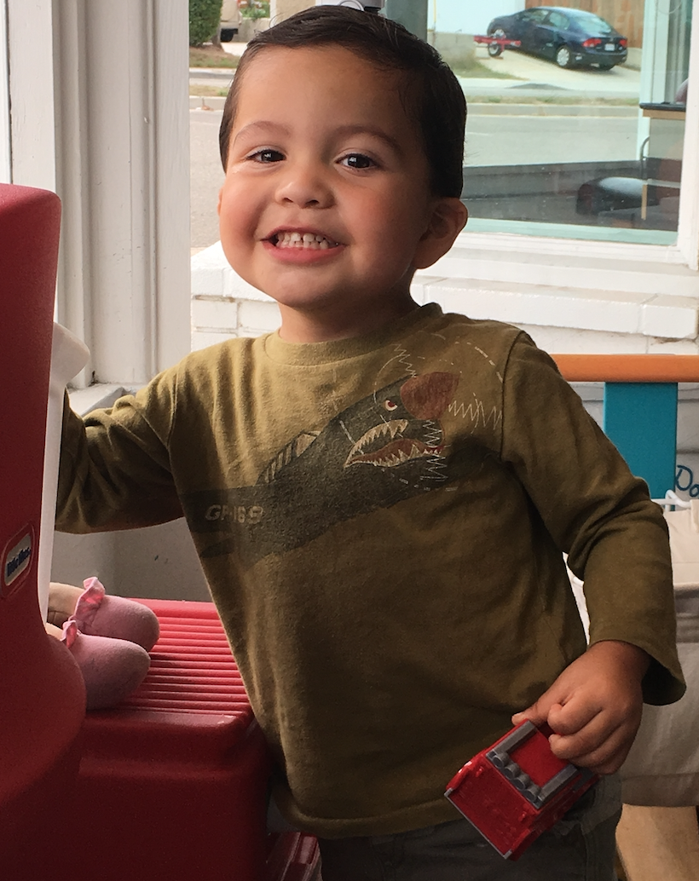
BAM!
Notes:
We did it! So, to recap before we move on to _____:

Slide 18
Take-home points
Viral infections are very common; also think about UTI
Infants 0-28 days are very high risk → full sepsis workup, antimicrobials, admission
Infants 29-60 days are intermediate risk → inflammatory markers play a bigger role
Infants 61 days-6 months are lower risk → consider UTI
Infants & kids over 6 months are lowest risk → symptom-based evaluation and consider UTI
Notes:
As you’re contemplating evaluation of these kids, make sure to manage them.

Slide 19
Thank you!

Slide 20
References
AAP COMMITTEE ON INFECTIOUS DISEASES. Recommendations for Prevention and Control of Influenza in Children, 2018–2019. Pediatrics. 2018;142(4):e20182367
Allan GM, Ivers N, Shevchuk Y. Treatment of pediatric fever: Are acetaminophen and ibuprofen equivalent? Can Fam Physician 2010;56(8):773.
Antoon JW, Potisek NM, Lohr JA. Pediatric Fever of Unknown Origin. Pediatr Rev. 2015;36(9):380-390. doi: 10.1543/pir.36-9-380.
Aronson PL, Wang ME, Shapiro ED et al. Risk Stratificiation of Febrile Infants </= 60 Days Old Without Routine Lumbar Puncture. Pediatrics 2018;142(6):e20181879.
Chang L, Chi H, Chiu NC. Etiologies of fever with Leukocytosis in Patients of Pediatric Emergency Department: A Brief Report. Pediatr Emerg Care 2015;31(9):e9. doi: 10.1097/PEC.0000000000000551.
Cioffredi LA, Jhaveri R. Evaluation and Management of Febrile Children: A Review. JAMA Pediatr 2016;170(8): 794-800. doi:10.1001/jamapediatrics.2016.0596.
de Vos-Kerkhof E, Nijman RG, Vergouwe Y, Polinder S et al. Impact of a Clinical Decision Model for Febrile Children at Risk for Serious Bacterial Infections at the Emergency Department: A Randomized Controlled Trial. PLoS ONE 2015;10:5): e0127620. Doi: 10.1371/journal.pone.0127620.
Dorney K, Bachur RG. Febrile infant update. Curr Opin Pediatr 2017;29:280-285. Doi: 10.1097/MOP.0000000000000492.
Gomez B, Mintegi S, Bressan S, Da Dalt L et al. Validation of the “Step-by-Step” Approach in the Management of Young Febrile Infants. Pediatrics. 2016;138(2):e20154381.

Slide 21
References
Greenhow TL, Hung Y, Pantell RH. Management and Outcomes of Previously Health, Full-Term, Febrile Infants Ages 7 to 90 Days. Pediatrics. 2016;138(6):e20160270.
Greenhow TL, Hung Y, Herz A. Bacteremia in Children 3 to 36 Months Old After Introduction of Conjugated Pneumococcal Vaccines. Pediatrics 2017;139(4): e2062098.
Kuppermann N, Dayan PS, Levine DA et al. A Clinical Prediction Rule to Identify Febrile Infants 60 Days and Younger at Low Risk for Serious Bacterial Infection. JAMA Pediatr 2019;173(4): 342-351.
Leibovitz E, David N, RIbitzky-Eisner H, Madegam MA et al. The Epidemiologic, Microbiologic and Clinical Picture of Bacteremia among Febrile Infants and Young Children Managed as Outpatients at the Emergency Room, before and after Initiation of the Routine Anti-Pneumococcal Immunization. Int. J. Environ. Res. Public Health 2016;13,723; doi: 10.3390/ijeroh 13070723.
Murray AL, Alpern E, Lavelle J, Mollen C. Clinical Pathway Effectiveness: Febrile Young Infant Clinical Pathway in a Pediatric Emergency Department. Pediatr Emer Care 2017;33: e33-e37.
Payson A, Etinger V, Napky P et al. Risk of Serious Bacterial Infections in Young Febrile Infants with Covid-19. Pediatr Emerg Care; 2021;37(4):232-236.
Ramgopal S, Janofsky S, Zuckerbraun NS, Ramilo O et al. Risk of Serious Bacterial Infection in Infants Aged <60 Days Presenting to Emergency Departments with a History of Fever Only. J Pediatr 2019;204:191-195.
Starr M. Reducing fever to its simplest form. J Paediatr Child Health 2016;52(2):109-111.
Subcommittee on Urinary Tract Infection, Steering Committee on Quality Improvement and Management. Urinary Tract Infection: Clinical Practice Guideline for the Diagnosis and Management of the Initial UTI in Febrile Infants and Children 2 to 24 Months. Pediatrics 2011;128:595-610.
Wing R, Dor MR, Mcquilkin PA. Fever in the Pediatric Patient. Emer Med Clin N Am 2013;31:1073-1096.
Woll C, Neuman MI, Aronson PL. Management of the Febrile Young Infant: Update for the 21st Century. Pediatr Emer Care 2017;33:748-755.

